Slide 1
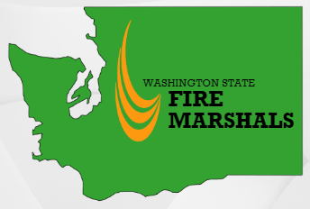
Round table – wui code
Traci Harvey, Mark Jung, Dave Nalle, Karen Grove
2022 Fire Prevention Institute

Slide 2
INTRODUCTIONS
Current code and maps
Where the State code is (possibly) headed
Setting up a WUI program – experiences from around the state

Slide 3
Current code
RCW 19.27.560
(a) Section 504 Class 1 Ignition-resistant construction
(i)(A) 504.2 Roof Covering – Roofs shall have a roof assembly that complies with a class A rating when testing in accordance with American Society for Testing Materials E 108 or Underwriter Laboratories 790. For roof coverings where the profile allows a space between the roof covering and roof decking, the space at the eave ends shall be fire stopped to preclude entry of flames or embers or have one layer of seventy-two-pound mineral -surfaced, non-perforated camp sheet complying with American Society of Testing Materials D 3909 installed over the combustible decking.
(B) The roof covering on buildings or structures in existence prior to the adoption of the wildland urban interface code under this section that are replaced or have fifty percent or more replaced in a twelve-month period shall be replaced with a roof covering required for new construction based on the type of ignition-resistant construction specified in accordance with section 503 of the International Wildland Urban Interface Code....

Slide 4
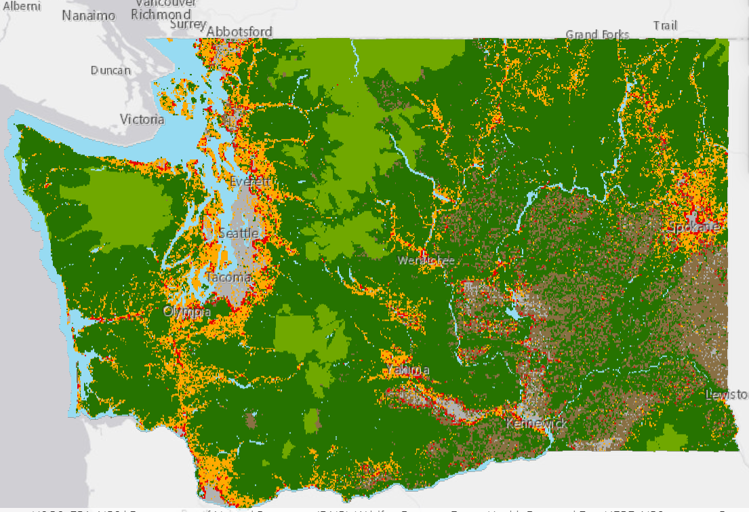
Current DNR map

Slide 5
2021 state code and wui
Upcoming vote at SBCC next week
TAG proposals – 2022 efforts to adopt the full WUI with WA amendments

Slide 6
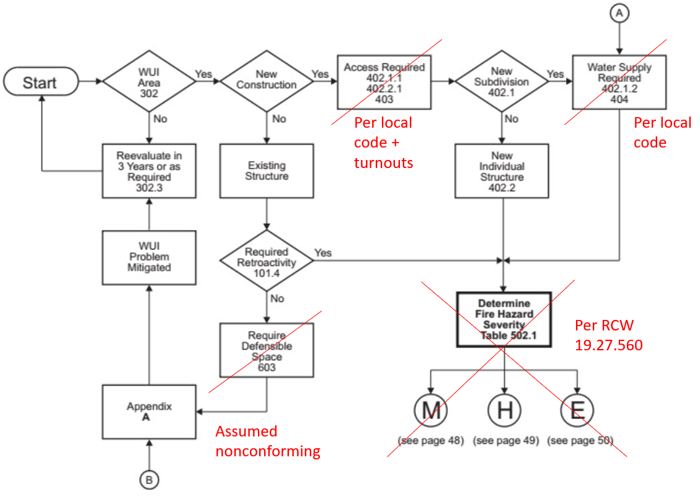
2021 state code and wui
Upcoming vote at SBCC
TAG proposals

Slide 7
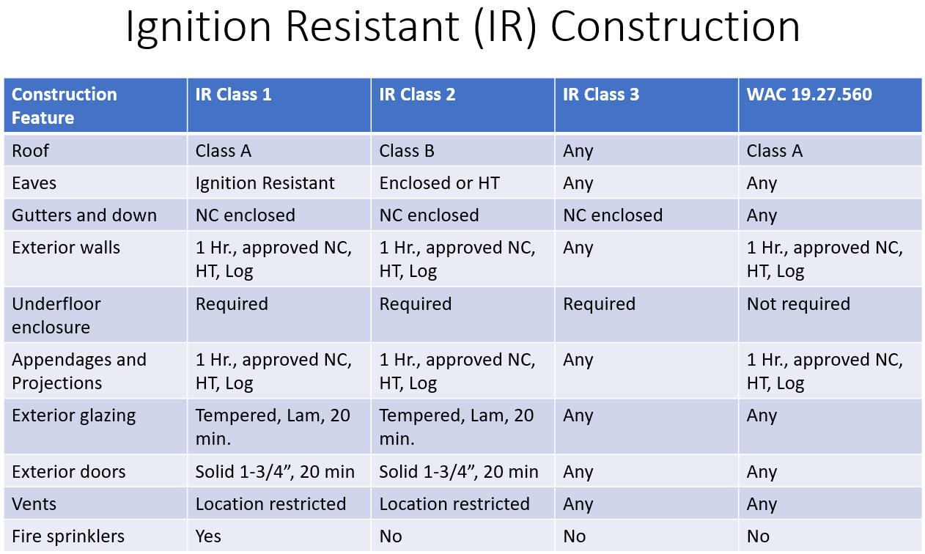
2021 state code and wui

Slide 8
OBSERVATIONS ON SETTING UP A WUI PROGRAM
Review map: #s, changes?
Engage the building official – swim lanes?
Permitting – changes needed to routing/systems?
Local ordinances?
Action plan for City-owned parcels/buildings?
Other?

Slide 9
Thank you
Mark Jung, Fire Marshal, City of Kirkland
MJung@kirklandwa.gov
Dave Nalle, Deputy Chief, Chelan County Fire District #3
dave@chelanfd3.org
Traci Harvey, Fire Protection Engineer, Spokane Valley FD HarveyT@spokanevalleyfire.com
Karen Grove, Fire Prevention Director, Seattle FD karen.grove@seattle.gov

